Slide 1
Reproducible Clinical Data Analysis with R and RStudio
Session 3
Exploring Data
Notes:
As I had mentioned before, a main goal of this course is for participants to become comfortable using outside resources for just-in-time learning of the skills necessary to accomplish a specific task. From here on out, I’ll start pointing out resources to learn more.

Slide 2

Notes:
Here’s one course that I would recommend to anyone to review and deepen the material we’re covering today. Intro to the tidyverse covers data wrangling, data visualization, and grouping and summarizing. It’s taught by David Robinson who is a thought leader in data science and also a great educator.

Slide 3
Introduction | 8:30 – 10:00
Getting Data | 10:10 – 11:45
Lunch | 11:45 – 12:30
Exploring Data | 12:30 – 2:30
Reproducible Reports | 2:40 – 4:00

Slide 4
Visualizing Data

Slide 5
Your Turn #1
How do you think the ESR results are distributed?
Discuss with your group.
Notes:
Last time we looked at a data set with ESR lab values from CERNER. How do you think they are distributed? Don’t look at the data.

Slide 6
Notes:
You might have expected that it’s normal or bimodal (with normal and abnormal values).
Instead the maximum is close to zero and there’s a long tail on the right, with no clear separation of normal and abnormal values.
This is not at all clear from looking at a table with almost 250,000 rows.
The point of this exercise is that you might have preconceived ideas about your data, but they often aren’t accurate. Being able to visualize data quickly is critical for understanding.
Delete from PDF deck

Slide 7
A grammar of graphics for data visualization
library(tidyverse)
Notes:
We’ll be using the ggplot package for creating graphics. ggplot is part of the tidyverse so it will get loaded when you load the tidyverse metapackage by running library(tidyverse)
GGplot provides a "grammar of graphics" for data visualization. The idea is that you can build any type of graph by specifying the data, a function that specifies the type of graph, and a mapping that describes how the data should be represented as visual marks on that graph.
So there should be a consistent way, or a grammar, to construct any type of graph.
The advantage of ggplot2 over other graphics packages for R is this consistent grammar, which makes it easy to try out a bunch of different ways to display your data without having to change much code.

Slide 8
ggplot()
initialize a plot
with ggplot()
+ sign
(at end of line)
data frame
ggplot(data = esr) +
geom_histogram(mapping = aes(x = RESULT))
mappings inside
aes() function
type of graph
“aesthetic” mapping
Notes:
Here is how you use ggplot.
You can see that we give it a data frame, in this case, our ESR data
We specify the type of graph, or “geom”, in this case, a histogram
And we specify an aesthetic mapping, in this case, saying that we want the variable “Result” which contains results of ESR testing values, on the x axis.
A few more details to note: you always start a plot with the ggplot() function
To connect the ggplot function to the geom function you use a ‘+’ sign which should be put at the end of the line
And the mappings need to go into the aes() function

Slide 9
To make any kind of graph:
1. Choose a “tidy”
data frame
ggplot(data = data_frame) +
geom_function(mapping = aes(mappings))
2. Pick a “geom” function
3. Write aesthetic mappings
Notes:
So that was a lot of information. Let’s try to break it down into a mental model. Here’s a template for making any kind of graph with ggplot2.
Pick a tidy data frame
Choose a geom function
Write aesthetic mappings

Slide 10
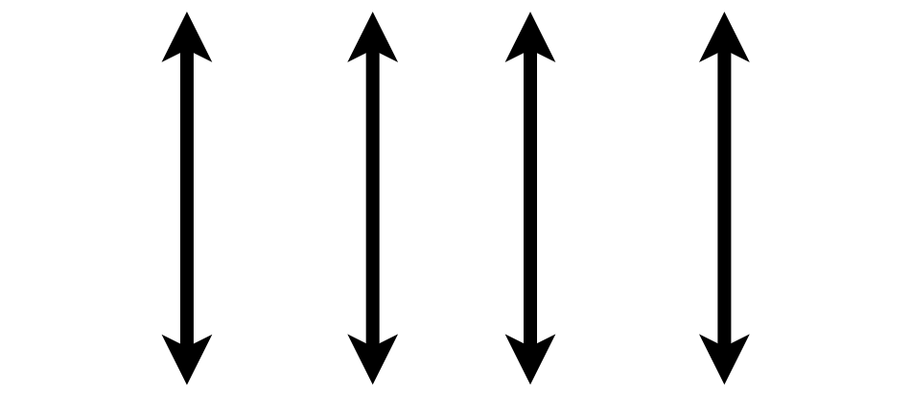

1. Pick a “Tidy” Data Frame
A data set is tidy if:
Each variable is in its own column
Each case is in its own row
Each value is in its own cell
Notes:
This is a good time to introduce the idea of ”tidy” data that also gives the “tidyverse” its name.
Any data set can take on a lot of different shapes. But there is one shape that is best suited for data analysis, and that shape is called ”tidy.”
The opposite of “tidy” data is often called “messy” and often times one of the first data analysis tasks is to convert “messy” data into “tidy data.”
The good news is that a lot of times, data that comes from databases is already tidy. That’s also the case for our esr data set of which I’m showing a small piece here.
A data set is tidy if: each variable is in its own column,
Each case is in its own row
Each value is in its own cell

Slide 11

Notes:
If you find yourself with a data set that is NOT tidy I recommend you check out this Datacamp course titled "Cleaning Data in R".

Slide 12
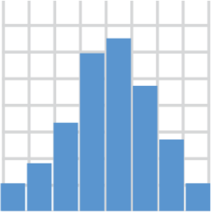
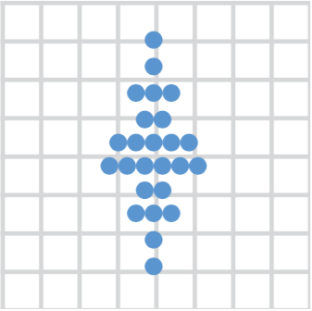
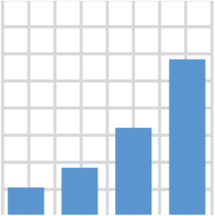

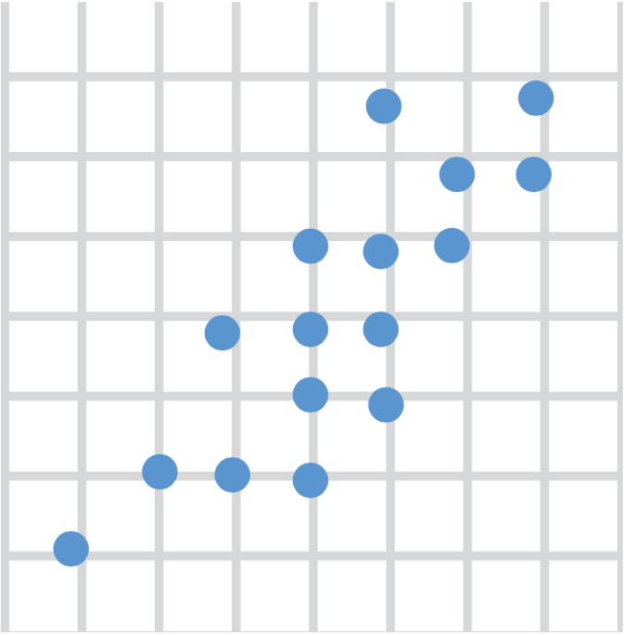
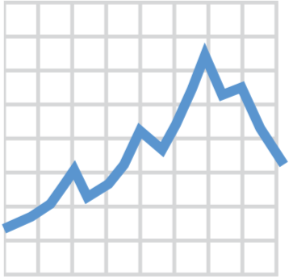
2. Choose a “Geom” Function
geom_histogram()
geom_dotplot()
geom_bar()
geom_boxplot()
geom_point()
geom_line()
Notes:
There are many different ways data can be displayed, and to tell ggplot what type of graph you want you pick a geom_ function.
Here are the top 6 most useful geom functions for visualizing clinical data, but there are many more. With these 6 you can make histograms, bar plots, scatter plots, dot plots, boxplots, and line plots.

Slide 13
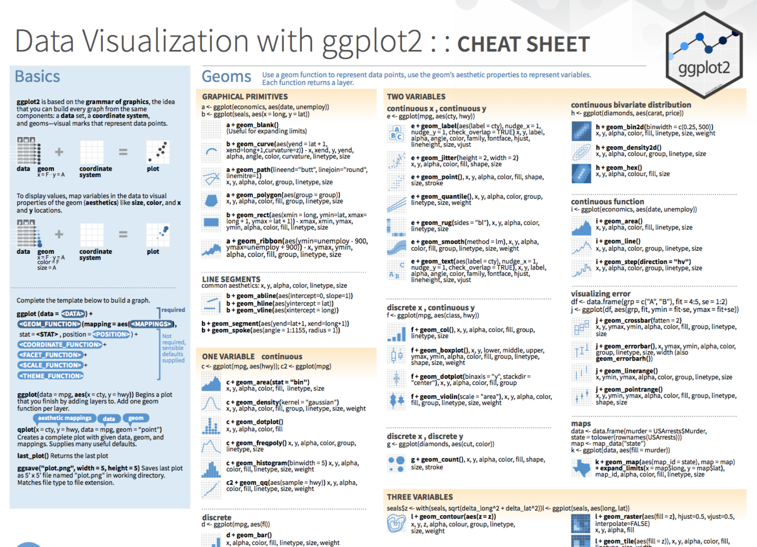
Notes:
The ggplot2 Cheat Sheet (hand out) is great to have on hand as you’re exploring your data with ggplot.

Slide 14
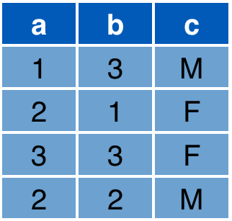

3. Write Aesthetic Mappings
aes(x = a, y = b, color = c)
Data frame
Graph
y
x
Notes:
So now we've picked a tidy data frame, we've picked a geom function, what's left now is to write aesthetic mappings.
So what's an aesthetic mapping? An aesthetic mapping is a specification of how you what the columns of your data frame represented as graphical markings on your plot.
For example, consider this data frame with 3 columns a, b, c, and this x/y graph.
* The aesthetic mapping above defines that x axis value of each marking should come from the "a" column
The y axis value from the "b" column
And since we’re now out of axes, we can define that the color should come from the "c" column. R figures out a reasonable color scale but you can fine tune this.
As a result, you get the expected graph.

Slide 15
Aesthetics
From Fundamentals of Data Visualization, by Claus Wilke, licensed under CC-BY-NC-ND
Notes:
Let’s take a closer look at aesthetics. Here are some very commonly used ones – position, shape, size, color, line width, or line type. ggplot treats all of these as equivalent, and you can map each of these to a different variable to create complex visualizations of multivariate data.

Slide 16
Your Turn #2
Log onto the RStudio Server by pointing your browser to:
https://rstudio.uphs.upenn.edu:40400
Open 03-exploring-data.Rmd. Work through the section “Your Turn #2: Visualizing Data”.

Slide 17
Notes:
Unfortunately we can only scratch the surface of ggplotting in this workshop, but I wanted to give you a sense of what else you can do with ggplot. You can adjust the position of objects…

Slide 18
Notes:
You can use different themes which affect how non-data elements such as axes, gridlines, and background appear.

Slide 19
Notes:
You can customize color scales.

Slide 20
Notes:
Facets are a way to break down a plot into sub-plots by a grouping variable, for example gender or location in the hospital.

Slide 21
Notes:
Ggplots also allow plotting in radial coordinates or on geographical maps.

Slide 22
Notes:
And of course you can add titles and captions.

Slide 23
ggplot(data = data_frame) +
geom_function(mapping = aes(mappings)) +
theme_function +
scale_function +
facet_function +
coordinate_function +
...
Required
Optional
Notes:
All of these modifications, like themes, color scales, facets, coordinate systems, and labels, can be added in the same way that we added geom layers – by writing a plus sign followed by a theme function, a scale function, a facet function, etc. You can find out about these functions on the Data Visualization Cheat Sheet.

Slide 24

Notes:
The introduction to tidyverse Datacamp course already covers a lot of ggploting, but there’s a more extensive course as well. I wouldn’t worry about anything more than the first part of it.

Slide 25
Isolating Data
Notes:
We'll next talk about subsetting, or isolating data.

Slide 26

A grammar to transform
rectangular data
library(tidyverse)
Notes:
Often times you have a large data frame but only want to create a graph from only a small part of it. Dplyr works great for this purpose.
Dplyr is a grammar to transform rectangular data, and it works best with tidy data. The idea behind dplyr is that any data analytic task can be broken down into a small number of basic or atomic tasks, and there should be a consistent way to specify each atomic task - a grammar.
Each dplyr function takes a data frame, does something with it, and then returns a modified data frame. Dplyr functions can be stringed together to create powerful data analysis pipelines in just a few lines of code.

Slide 27
select()
Extract columns by name.
select(data_frame, ...)
names of columns to extract
Notes:
The first dplyr function we’ll look at is select(). Select extracts columns from a data frame, by name.
Select takes a data frame as its first argument. After that it takes any number of additional arguments that specify the names of the columns that you want to pick.

Slide 28

select()
Extract columns by name.
select(esr, AGE, RESULT)
Notes:
For example, this select statement will take the data frame esr, and return a new data frame that only has the columns AGE and RESULT.
An important point to note here is that select will not modify the original data frame. If you write the select statement like this it will simply display the result in the console or in your R Notebook. If you want to capture the modified data frame you need to assign it to a named object.
Q for class: do you remember how to capture data in a named object? (work on white board)

Slide 29
filter()
Extract rows that meet logical criteria.
filter(data_frame, condition)
logical test (return each row for which the test is TRUE)
Notes:
One of the most important dplyr functions to know about is filter(). Filter extracts rows – not columns – based on logical criteria.
Like select, filter takes a data frame as its first argument. The second argument is a logical test. R then performs that logical test on each row of the dataset and returns all rows in which the logical test was true.

Slide 30
filter()
= sets
== compares
Extract rows that meet logical criteria.
filter(esr, SEX == "F")
Notes:
To give you an example: the logical test here is whether or not SEX is equal to the letter “F”.
This filter statement will return a data frame that only contains the rows of the data frame in which SEX equals “F”. So it’s a positive filter.
One potential pitfall I want to point out here is the difference between the single equals and the double equals operators.
You saw a single equals operator in the context of the aes() function where we set the x axis to a specific column name.
Here you see the double equals sign in the context of a logical test that compares the left hand side, e.g. SEX, with the right hand side, e.g. “F” to check whether or not they are the same.
If you use the wrong one you’ll get an error, and it’s a common enough error to be aware of.

Slide 31
Logical Tests
x < y | less than
x > y | greater than
x == y | equal to
x <= y | less than or equal to
x >= y | greater than or equal to
x != y | not equal to
is.na(x) | a missing value
Notes:
Here are some important logical operators to know about. They will all come in handy when you’re filtering rows of a data frame. x and y each represent expressions, at least one of which usually involves a column name. For example, AGE < 18. or SEX == Female. Or DRAWN_DT_TIME > RECEIVED_DT_TM.
We’ve already seen the double equals. Note the less than or and greater than operators. These operators also come as “or equal to” versions.
Use != if you want to select rows in which a value is not equal to another vale.
is.na is how you can test for missing values. This comes in handy when you want to remove missing values from your data, which we’ll see later.

Slide 32
arrange()
Order rows from smallest to largest.
arrange(data_frame, ...)
names of columns to order by (additional columns = tie breakers)
Notes:
arrange() is a dplyr function that can be used to order rows, by default from smallest on top to largest on the bottom, or "ascending".
arrange() takes a data frame as its first argument and after that names of columns to order by. If you give arrange more than one column name, then this will be used as a tie breaker for the first column, and so on.

Slide 33
arrange()
descending order: desc(AGE)
Order rows from smallest to largest.
arrange(esr, AGE)
Notes:
For example, we can arrange esr by AGE which I'm showing graphically here.
* To arrange in descending order, wrap the column name in the desc() function – for “descending”.

Slide 34
%>%
Notes:
I’ll now introduce one of the most powerful concepts in the tidyverse – the pipe operator, which is written as percent-greater than-percent.
I’ll first show you exactly what it does, and then why it’s so useful.

Slide 35
The Pipe Operator %>%
esr filter( , SEX == "F")
%>%
Passes the object on the left as first argument to the function on the right.
esr %>% filter(SEX == "F")
filter(esr, SEX == "F")
Notes:
The pipe operator takes what's on its left - here the esr data frame - and plugs it as the first argument of the function on its right - here as the first argument to the filter function.
So these two lines of code...
esr %>% filter(SEX == "F")
filter(esr, SEX == "F")
...are equivalent. In both cases esr is treated as the first argument to the filter() function.

Slide 36
”then”
esr %>%
select(AGE, SEX, RESULT) %>%
filter(SEX == "F") %>%
arrange(RESULT)
Notes:
So here’s why this is so useful.
Tidy functions (such select, filter, arrange, and others we’ll see later) always have as first argument a data frame, and they always return a data frame.
This makes it possible to create a pipeline in which a data frame object is handed from one tidy function to the next.
* The pipe operator is usually pronounced “then”.
For example, here we start with esr, then select the AGE, SEX, and RESULT columns, then filter for SEX equal to “F”, then arrange by “Result”.
You’ll get a pipeline of data analysis steps which are concise and also fairly human readable. This is powerful because you’ll be able to explain to someone who isn’t a programmer or statistician (this may include yourself 6 months down the road or a collaborator who doesn’t know R) exactly what you did.

Slide 37
Your Turn #3
Return to 03-exploring-data.Rmd.
Complete the section “Your Turn #3: Isolating Data”.

Slide 38
Augmenting Data
Notes:
This section is about adding new data columns to an existing data frame, either derived from that same data frame, or by joining with a different data frame. We won’t go into joining data but it’s relatively straightforward to do with dplyr, and I’ll give you some resources later on.

Slide 39
mutate()
Create or modify columns.
mutate(data_frame, ...)
name-value expressions
column_name = value
Notes:
Mutate is an extremely useful dplyr function. You can use mutate() to add a new column to the data set or modify that column if it already exists.
Like all tidy functions, it takes a data frame as its first argument. After that, you tell it what to name the new column and what should be in it. This is done using name-value expressions.
In name-value expression, you have a name, a single equals sign, and a value. The name is the name of the column that you’d like to create or modity. The value can be a constant, e.g. “100”, or an expression that involves other variables from the same data frame.

Slide 40
mutate()
Create or modify columns.
mutate(esr,
BIRTHYR = year(DRAWN_DT_TM) - AGE)
Notes:
For example, here I create a new column named BirthYr in which each value should be equal to the year of the draw time minus AGE.

Slide 41
Grouping and Summarizing Data
Notes:
The final concept I want to introduce today is grouping and summarizing.

Slide 42
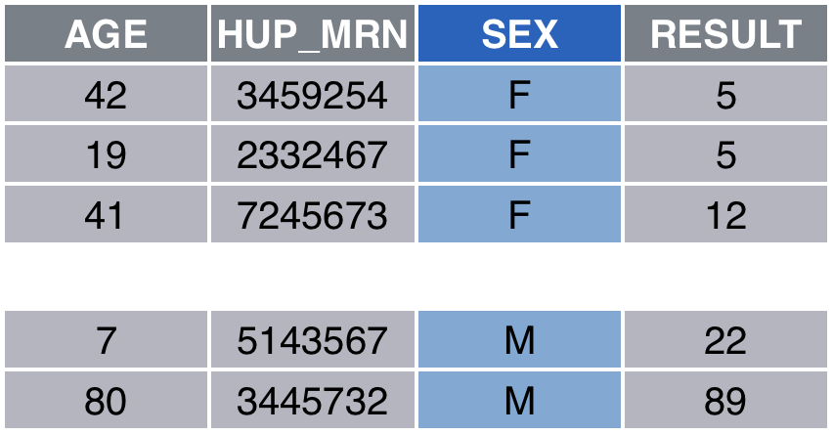
esr %>%
group_by(SEX) %>%
summarize(MeanAge = mean(AGE),
MeanESR = mean(RESULT))
Notes:
Let's look at an example. Let's say I want to know the mean patient age from the esr data frame, but grouped by patient sex.
Here we pass esr to the group_by function and tell it to group by SEX, which is a categorial variable. Group_by breaks up the data frame into pieces – one for each possible value of SEX. In this case, we’ll get 2 pieces, one for SEX=F and SEX=M.
The summarize function works a lot like the mutate function in that it takes name-value expressions. The important difference here is that summarize applies *aggregate functions* such as mean, median, etc. that collapse a variable into a single number.
So summarize returns a tidy data frame where the each calculated summary statistic is in its own column, and each row represents a group defined by group_by.
Again: we start with esr - group_by splits it by SEX - summarize then calculates means for each group and returns a tidy data frame with a row for each group and a column for each summary statistic.
Q: what do you guys think would happen if you left out the group_by expression?

Slide 43
Summary (Aggregate) Functions
x = column name
n() | total count
n_distinct(x) | count of distinct values
mean(x) | mean
median(x) | median
sum(x) | sum
sd(x) | standard deviation
Set argument na.rm = TRUE to ignore missing values (NA)
Notes:
Here are a few of the most useful summary or aggregate functions.
N() gives the number of rows
N_distinct() gives you the number of rows with distinct values. X = the specific column to look at for deciding which rows are distinct.
Mean, median, sum, and sd calculate basic statistics. x = column to calculate the statistic on.
One problem with these functions is that they get tripped up by missing values. So if there are any missing values in the column that you want to summarize, you can pass the argument na.rm = TRUE, and the function will ignore missing values.

Slide 44
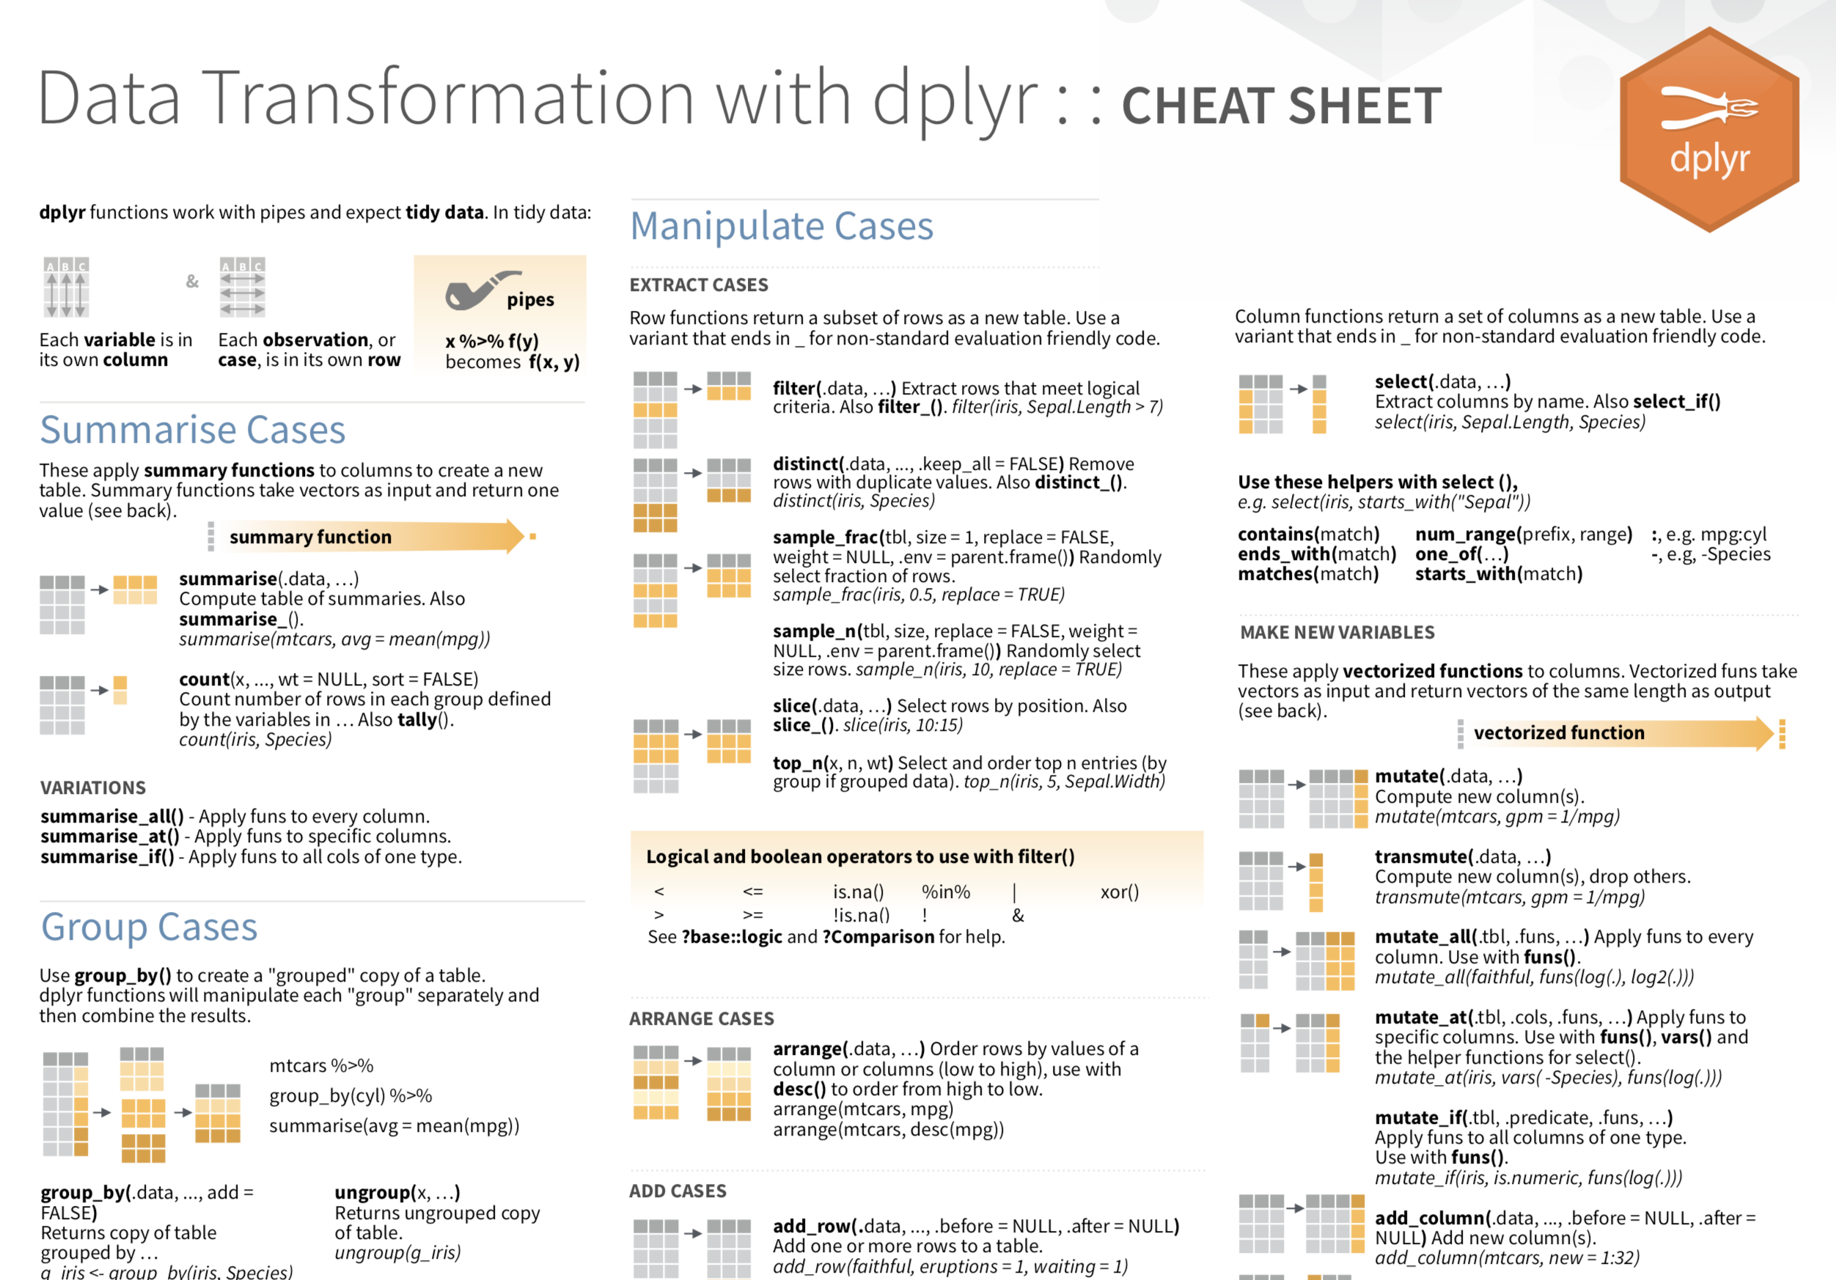

Slide 45
Your Turn #4
Return to 03-exploring-data.Rmd.
Complete the section “Your Turn #4: Grouping and Summarizing Data”.

Slide 46

Notes:
Second course – joining data frames

Slide 47
Notes for next time
Notes:
Make practice plots a bit prettier? Maybe filter initial data?
Better example for mutate
Filter() slide: why does “F” go in quotes? Because it’s a non-numeric literal value (?). Numeric values don’t go in quotes. Object names don’t go in quotes.
Logical tests – specify that x = a specific column, y = some expression which may also involve other columns.
Also: Summary (Aggregate) Functions slide

